Slide 1
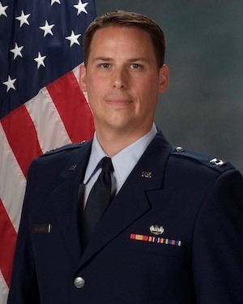
The
AREA DEFENSE COUNSEL
Works for YOU!
NOT YOUR COMMANDER
NOT THE LEGAL OFFICE
NOT ANYONE ON THIS BASE
I am here to protect YOU…
If YOU choose to exercise your right to counsel, I am here to help.
YOUR
COANG
AREA DEFENSE COUNSEL
Capt Daniel Westhoff
Call me if you are facing actions including:
• LOC/LOA/LOR • Separation • Reenlistment Denial
• Security Clearance Issues • Article 114
• Demotion • LOD/MEB/PEB/DES
• or any other action that may negatively
impact your service in the COANG
INDEPENDENT & CONFIDENTIAL
Area Defense Counsel
140 S. Aspen St., Bldg. 706 Room 125 daniel.westhoff.1@us.af.mil
Buckley AFB, CO 80011 Work Cell: 303-710-7326

